Slide 1
TOP-DOWN APPROACH

Slide 2
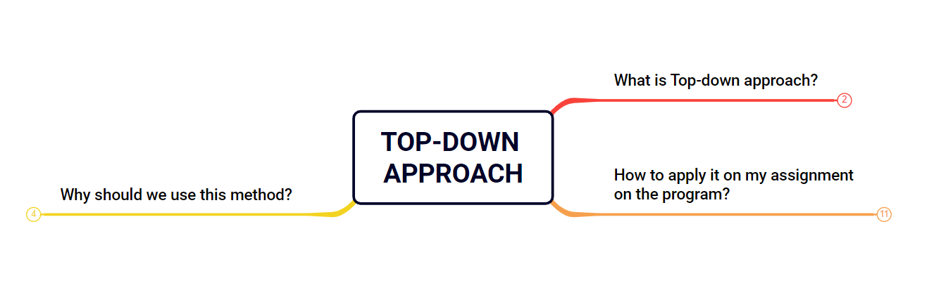

LEARNING HOW TO LEARN AND LEARN FAST

Slide 3
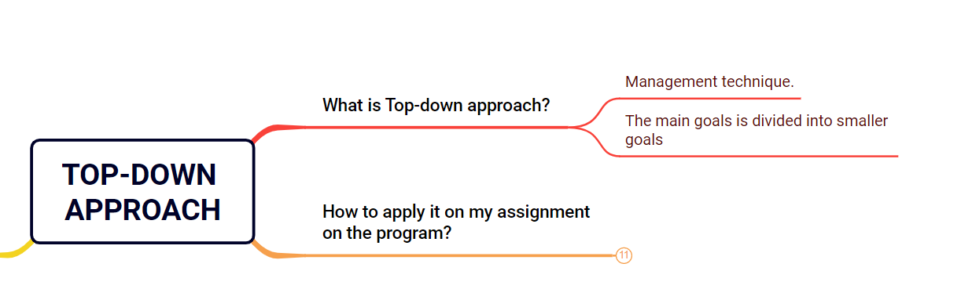
01. What is top-down approach ?

Slide 4
01. What is top-down approach ?
Big goal
“Top-down approach” is a management technique.
Starts with a goal, and then identifies the key issues from that goal.
The big goal is divided into medium goals, and the medium goals are further divided into many small goals.
Medium goals
Medium goals
Small goals
Small goals
Small goals
Small goals

Slide 5
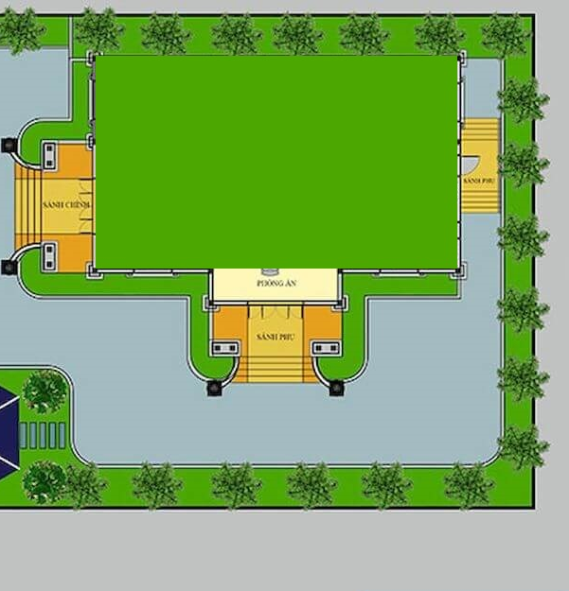
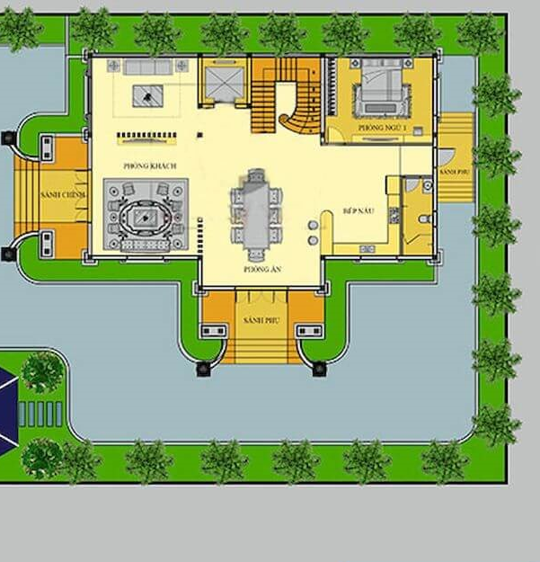
EXAMPLE

Slide 6
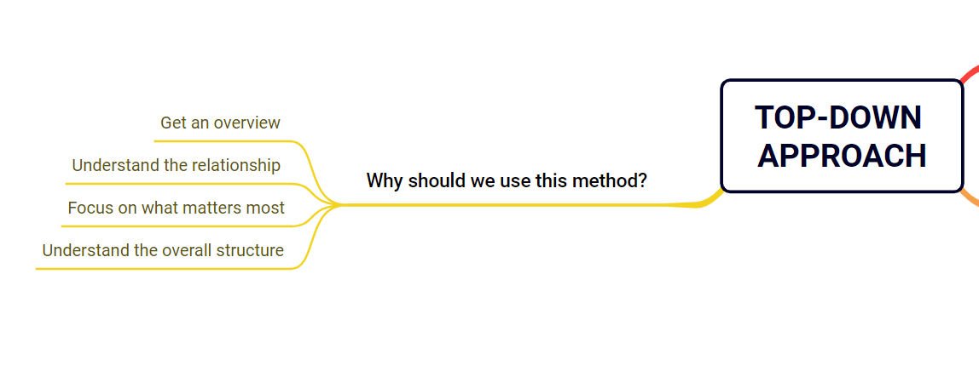
02. Why should we use this method?

Slide 7

02. Why should we use this method?
Get an overview of the topic.
Understand the relationship between concepts.
Focus on what matters most
Understand the overall structure.

Slide 8
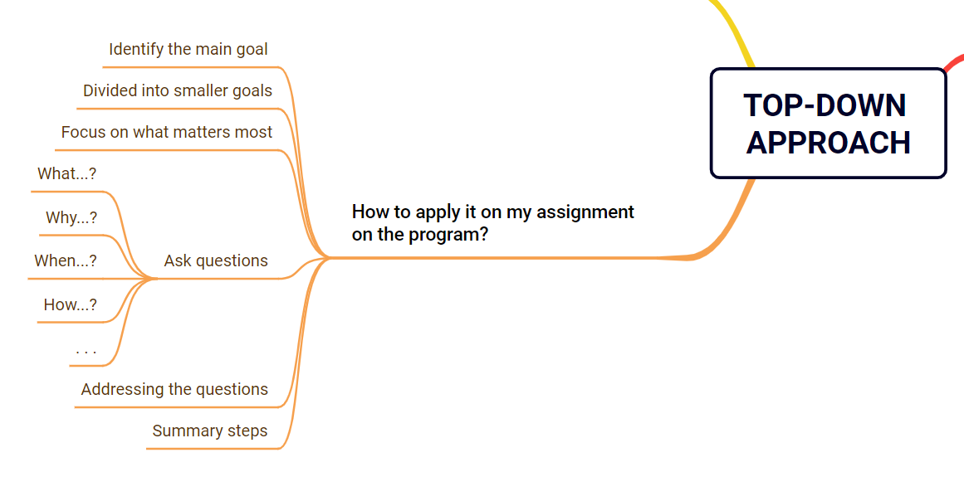
03. How to apply it on my assignment on the program?

Slide 9

03. How to apply it on my assignment on the program?
Identify the main goal of the assignment.
Divide it into medium goals and small goals.
Focus on what matters most
Ask questions (What...?, Why...?, When…? and How...?).
Addressing the questions posed.
Summary steps to complete the assignment.

Slide 10
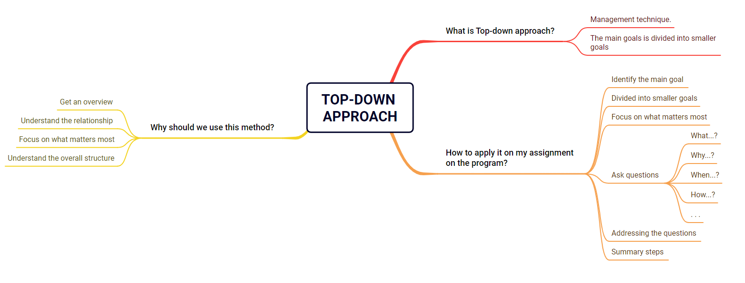
SUMMARY

Slide 11
THANKS!
Have a nice day!
Huynh Anh Tu

